Slide 1

Survival Analysis: An Overview

Slide 2
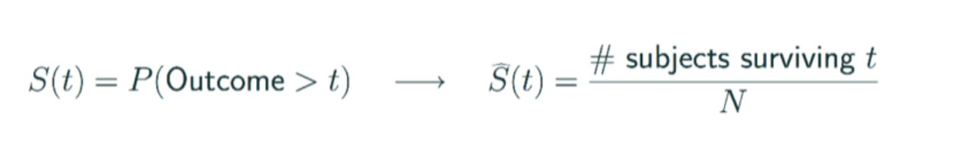
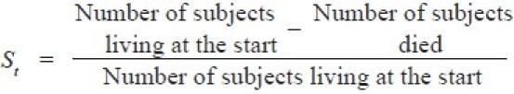

Kaplan-Meier Survival Curve

Slide 3
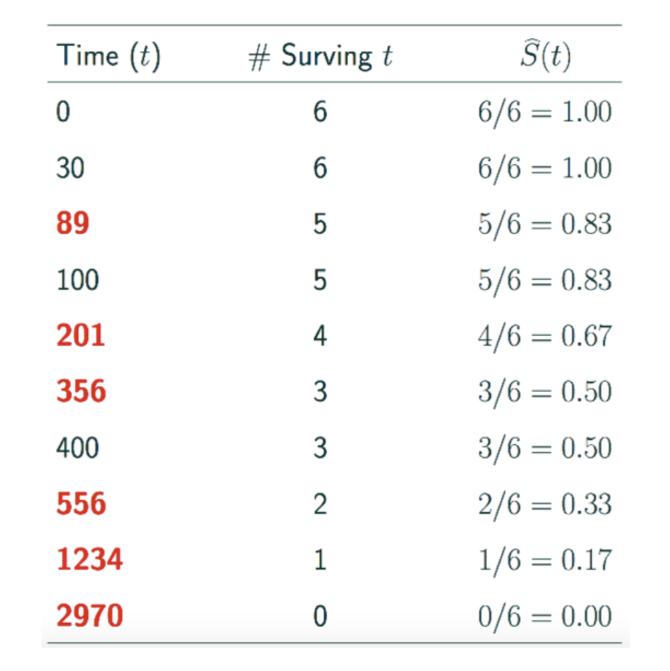
Illustrative Example

Slide 4
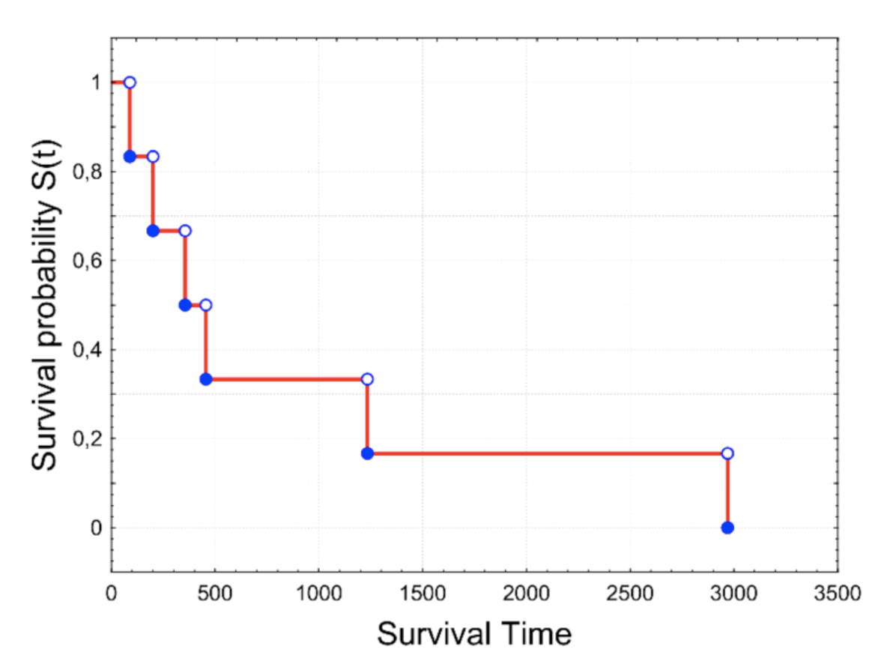
Illustrative Example

Slide 5
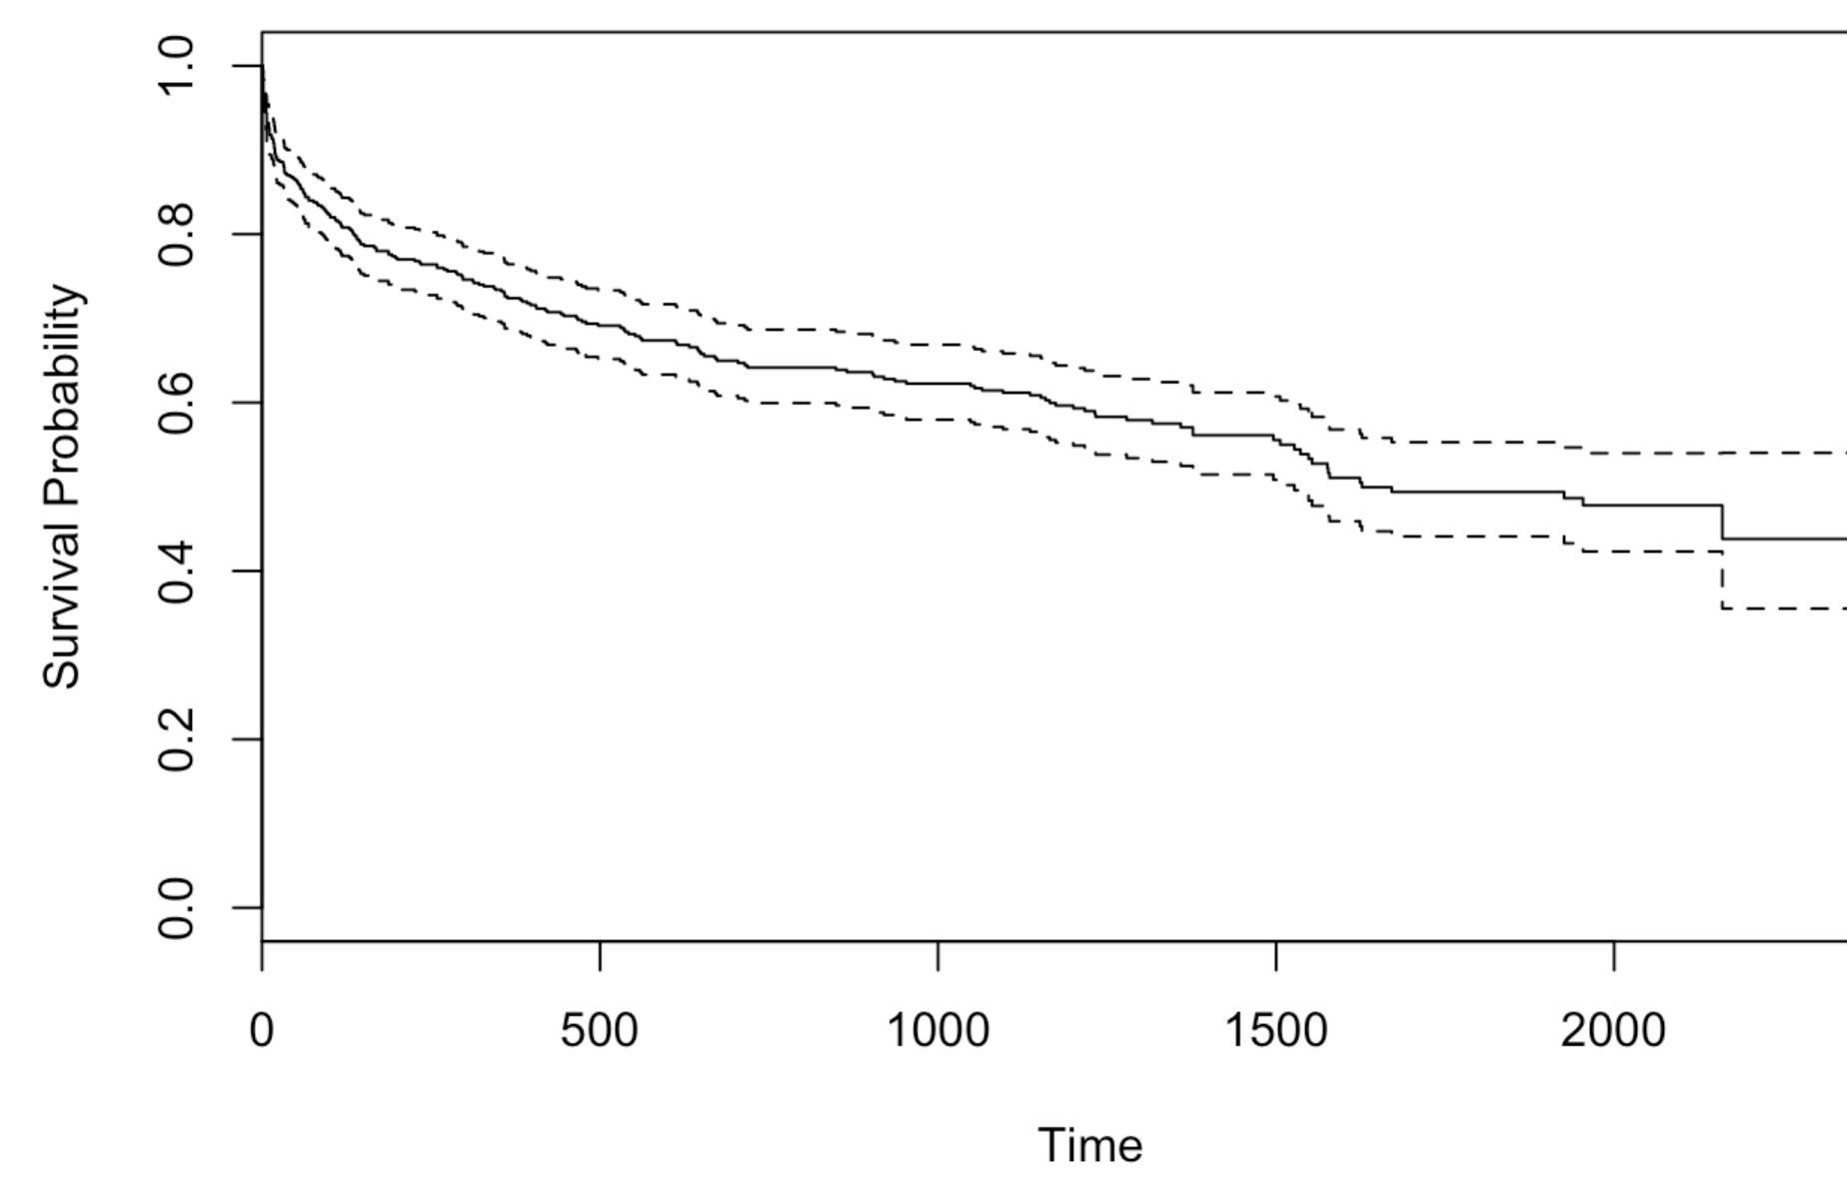
Illustrative Example

Slide 6
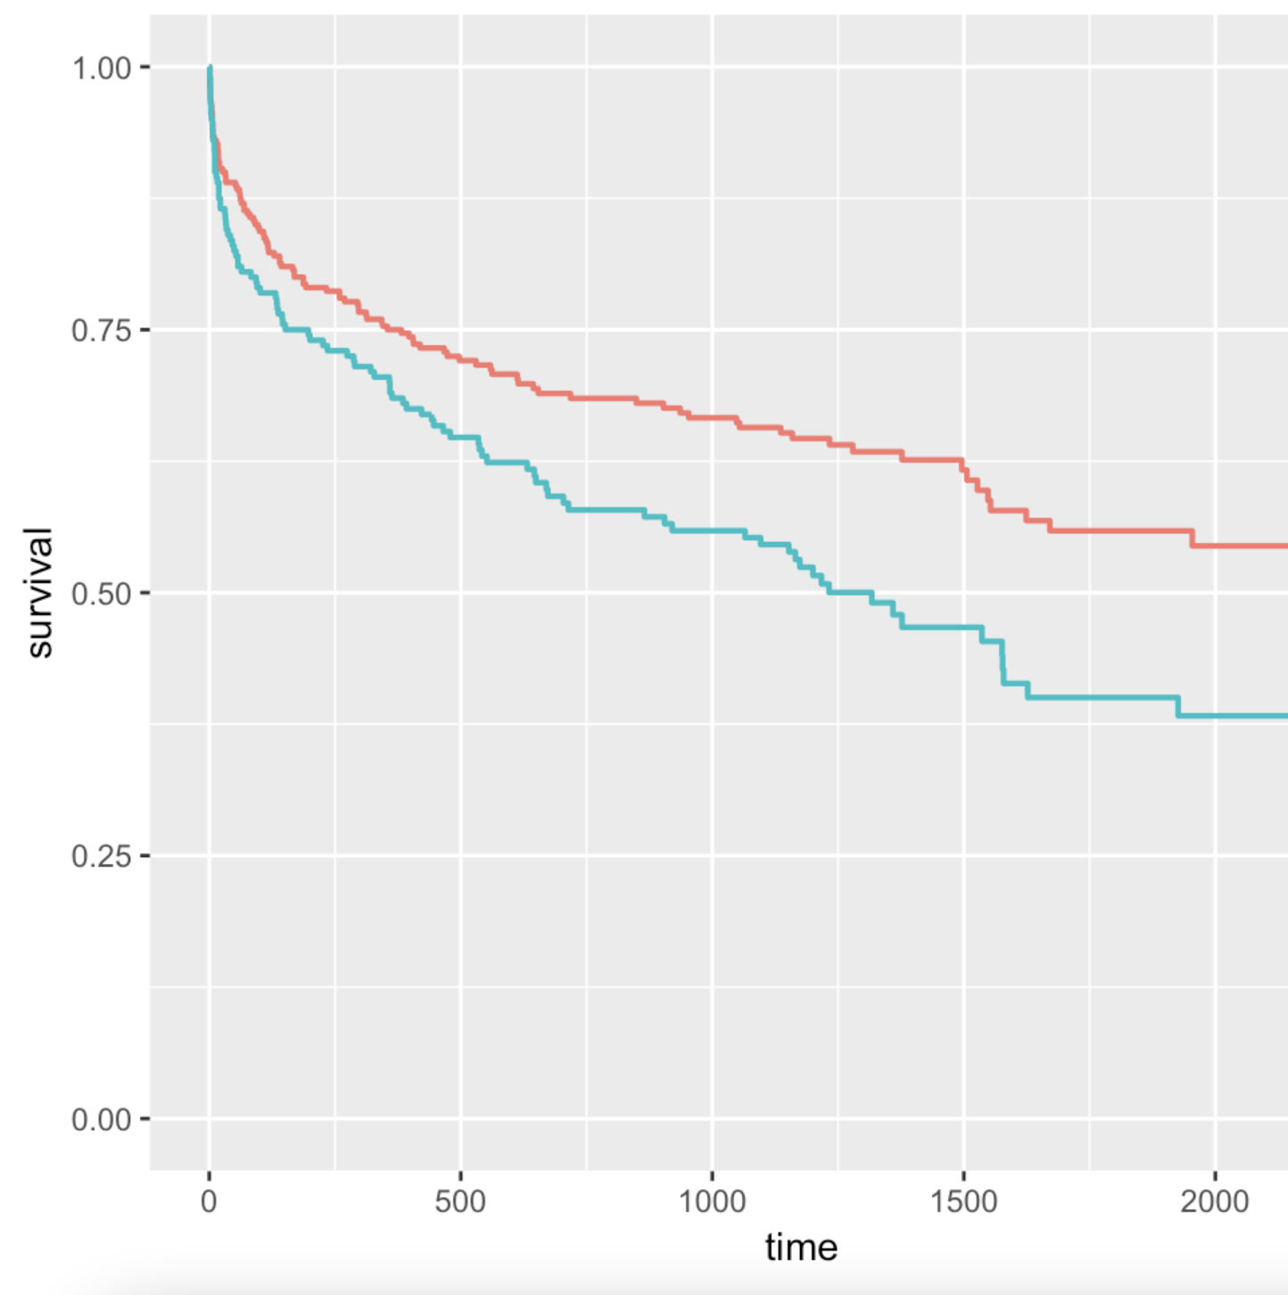
Illustrative Example

Slide 7
?

